Slide 1


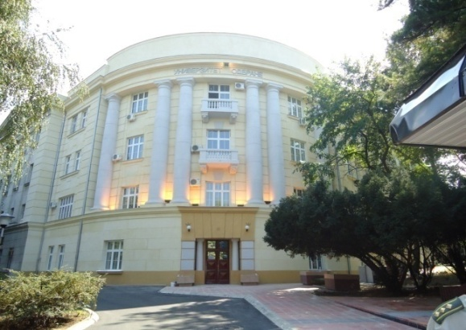
UNIVERSITY OF DEFENCE
UNIVERSITY OF DEFENCE
RECTOR
Major General
PhD Mladen Vuruna
1
Notes:
1
1

Slide 2
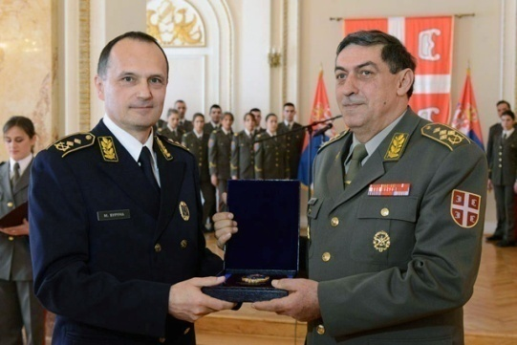
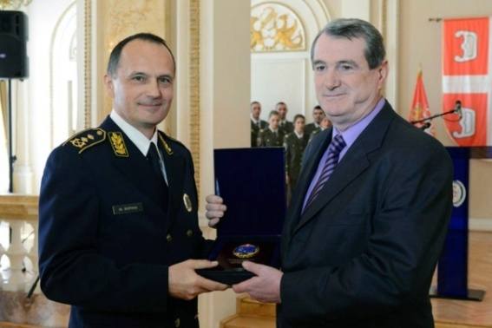
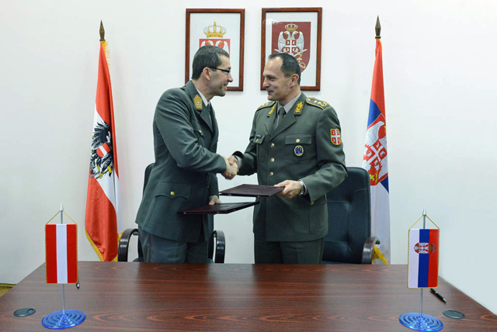
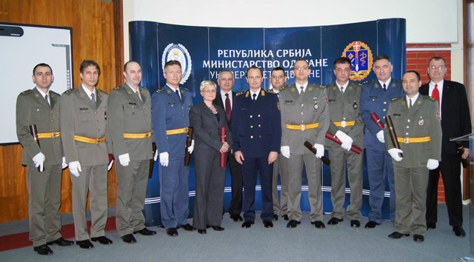
UNIVERSITY OF DEFENCE
“The University of Defence is very young state university, but it has two very significant higher education institutions of the Ministry of Defence and the Armed Forces of Serbia with a long tradition”
.
2
Notes:
2
2

Slide 3
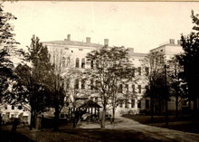
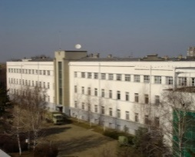
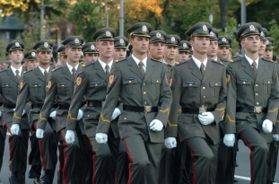
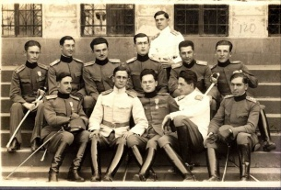
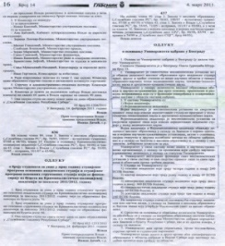
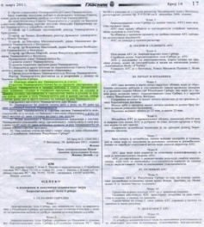
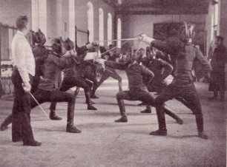
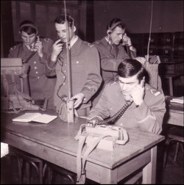
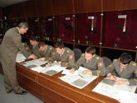
BACKGROUND
UNIVERSITY OF DEFENCE
24th February 2011
18th March 1850
The University of Defence has a long tradition that dates back to 18th March 1850, when Prince Aleksandar Karađorđević approved the establishment of the first military higher education institution in Serbia – Artillery school.
After the international recognition of the Principality of Serbia as an independent and sovereign state, in 1880, the National Assembly adopted the Law on the Organization of the Military Academy. Since then, the Military Academy has been working continuously through continuous organizational and structural changes, with the exception of interruptions during the Balkan wars and the First and Second World War.
The University of Defence was founded on February 24, 2011, and got its final structure through organizational and formation changes in October 2017.
3
Notes:
3
3

Slide 4
ORGANIZATION
UNIVERSITY OF DEFENCE
Minister of Defence
Rector
MMA Medical Faculty
National Defence School
Institute of Scientific Information
Strategic Research Institute
Military Academy
Military High School
-Military Act
-Military Technical Courier
-New Courier
-Military Medical Review
Military Archive
Military Vocational School
4
Notes:
4
4

Slide 5
BODIES
UNIVERSITY OF DEFENCE
17
Council
Rector
9
7
Quality
Assurance
Commission
Council of
Social Sciences and Humanities
13
Senate
Council of
Engineering and Technology
5
15
5
Cadet Parliament
Council of Medical
Sciences
5
Notes:
5
5

Slide 6
STUDIES
UNIVERSITY OF DEFENCE
INTEGRATED
ACADEMIC
STUDIES
(2)
UNDERGRADUATE
STUDIES
(9+1)
MASTER STUDIES
(11+2)
ACCREDITED
STUDY
PROGRAMMES
(38+3)
SPECIALIST STUDIES
(9)
PhD STUDIES
(6)
VOCATIONAL
STUDIES
(1)
6
Notes:
6
6

Slide 7
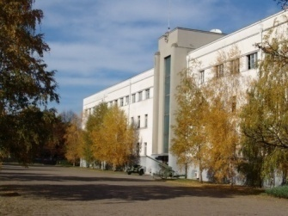
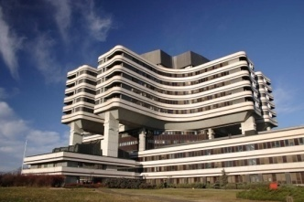
UNDERGRADUATE STUDIES
UNIVERSITY OF DEFENCE
Management
in
Defence
Military Mechanical
Engineering
CBRN
Air Defence
Vocational
Nurse
Military Electronic
Engineering
Defence
Logistics
Militar
Geodetic
Engineering
Military Chemical
Engineering
Public
Finances
Military
Industrial
Engineering
7
Notes:
7
7

Slide 8
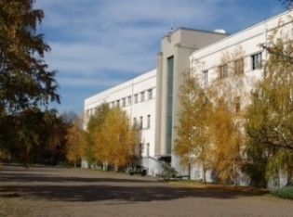
MASTER STUDIES
UNIVERSITY OF DEFENCE
Security Management
in Defence
Military Management
Military Electronic
Engineering
Management in
Defence
Defence Logistics
Military Mechanical
Engineering
Public
Finances
Military Topographic
Engineering
CBRN
Military Industrial
Engineering
Forensic Engineering
(english)
Military Chemical
Engineering
Mechatronics in
Vehicles
8
Notes:
8
8

Slide 9
INTEGRATED STUDIES
UNIVERSITY OF DEFENCE
Integrated Studies of Medicine
Integrated Studies
“Military Aviation”
9
Notes:
9
9

Slide 10

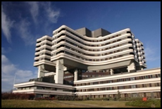
SPECIALIST STUDIES
UNIVERSITY OF DEFENCE
Defence Managemet
Oral Medicine
Medical Toxicology
Pharmacokinetics
and
Bioequivalence
Surgical-Orthodontic
Treatment
Implants in
Oral Medicine
Bioengineering
and
Medical Informatics
Oral Health
and
Periodontal Medicine
Traumatology
10
Notes:
10
10

Slide 11
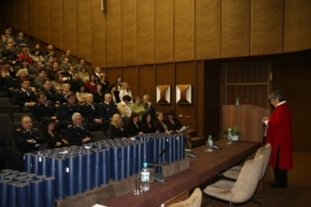
PhD STUDIES
UNIVERSITY OF DEFENCE
Management
in Defence
Biomedicine
Military Mechanical
Engineering
CBRN
Military Electronic
Engineering
Public Finances
11
Notes:
11
11

Slide 12

CAREER DEVELOPMENT COURSES
UNIVERSITY OF DEFENCE
Advanced Security
and
Defence Studies
General Staff Course
Command and Staff Course
Narrow
Specializations
Basic Command and Staff Course
Basic Specializations
Officer Career Development Courses
Doctor Career Development
Programs
12
Notes:
12
12

Slide 13
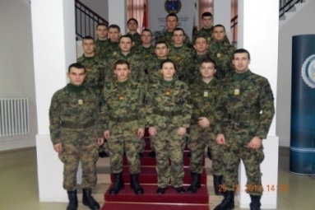
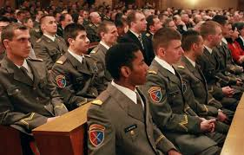
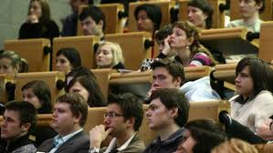
CADETS/STUDENTS
UNIVERSITY OF DEFENCE
Ministry of Defence / Armed Forces of Serbia
Members of foreign armed forces – 68
Bosnia and Herzegovina, Algeria, FYR Macedonia,
Croatia, Libya, Namibia, Nigeria, Montenegro
Self-financing Students – 269
13
Notes:
13
13

Slide 14
TEACHERS
UNIVERSITY OF DEFENCE
Professors – 51
Associate Professors – 48
Assistant Professors – 124
Teaching Associates - 122
415
Military Arts Professors – 26
Military Arts Teachers – 23
Foreign Language Teachers – 12
PT Instructors – 9
14
Notes:
14
14

Slide 15
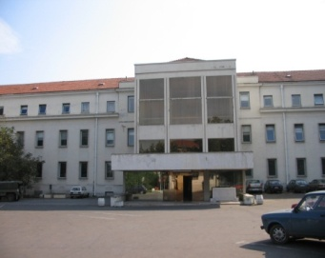
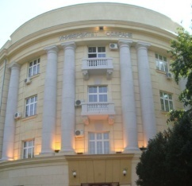


SCIENTIFIC RESEARCH
UNIVERSITY OF DEFENCE
Ministry of Defence
University of Defence
Military Technical Institute
Ministry of Education, Science
and Technological Development
Technical Test Centre
Military Geographical Institute
15
Notes:
15
15

Slide 16
SPECIFICITIES
UNIVERSITY OF DEFENCE
Law on Higher Education of RS, Law on Military Schools and Military Scientific Research Institutions, Law on Scientific Research, Law on Defence, Law on Military Education-draft
Military Arts professors and teachers
Article 51: (3) Higher education institutions for the implementation of study programs for the needs of police and military education, as well as for the needs of national security, shall be established by the Government, in accordance with the conditions laid down by this Law ... (8) Administrative supervision over the work of higher education institutions referred to in paragraph 3. hereof and the implementation of study programs from paragraph 5. and 6. hereof shall be performed by the state administration body in charge of internal affairs, national security and defence ...
Article 88 (4) In a higher education institution where a study program for the purposes of national security and military education is carried out, professional and applied subjects may also be taught by employees in the state administration body responsible for national security or defence matters in accordance with the law and the general statute of the higher education institution. (5) The higher education institution shall conclude a contract of engagement with the individuals referred to in paragraph 4 hereof.
16
Notes:
16
16

Slide 17
ACTIVITIES
UNIVERSITY OF DEFENCE
Training through simulations
  Virtual Battlespace 3.0 (VBS 3) – individual and platoon level
  JANUS 11.0 – BCSC and CSC
Centre for Simulations and Distance Learning: over 160 courses - 5 accredited for UN, approx. 2500 active users from 60 countries, more than 130 individuals qualified for use of distance learning platform and production of electronic teaching resources
Research
  Erasmus+
    Master Program “Natural Disaster Crisis Management” (UoD and universities from Serbia, Italy, Great Britain, Hungary, Greece, Bosnia and Herzegovina)
    Undergraduate, Master and PhD studies, “Improving Academic and Professional Education Capacities in the Republic of Serbia in the Field of Security and Protection through EU Strategic Partnership Tools” (UoD, Academy of Criminalistic and Police Studies, Faculty of Security Studies, universities in Germany)
    Mobility of teachers and students (UoD and NUPS Hungary)
  Horizon 2020 (applied for) – UoD and the University of Helsinki
17
Notes:
17
17

Slide 18
DEVELOPMENT AND TASKS
UNIVERSITY OF DEFENCE
Joint research projects with partner institutions
Increasing the number of master students
Reducing the number of study programs
Introduction of the simulator devices in the process of education and training
Improving inter-university and international cooperation through the exchange of lecturers and student conferences
18
Notes:
18
18

